Slide 1
Time Series Analysis
Yt

Slide 2
Data Types / Formats
Cross Sectional Data: Multiple entities at a given time period
Example: US, China, India, etc. unemployment rates in 2010
Time Series Data: One entity at multiple time periods
Example: US unemployment from 2010 to 2020
Panel Data: Multiple entities over multiple time periods
Example: US, China, India, etc. unemployment rates 2010 to 2020

Slide 3
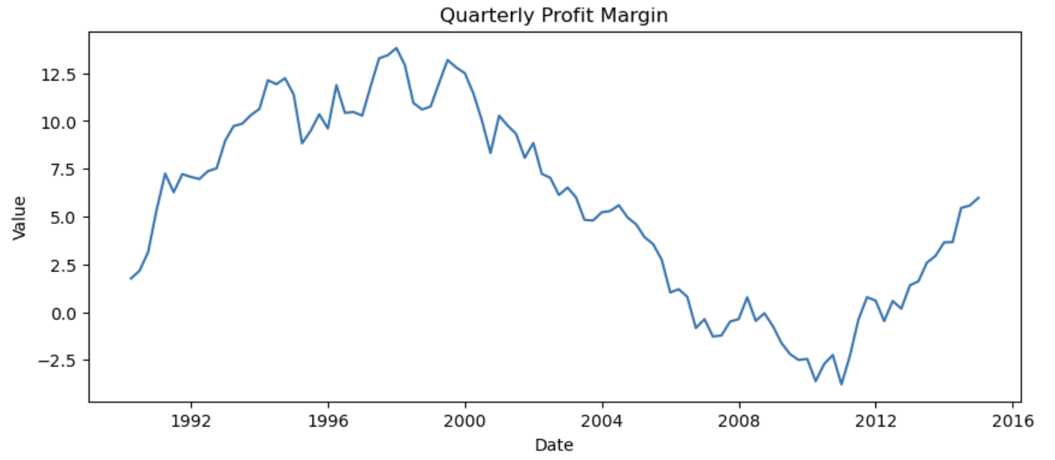
What is time series data?
Time Series Data: Data that is collected / recorded at regular intervals that is indexed / ordered chronologically.
Examples: Daily sales, monthly inflation, etc.
Key consideration: ORDER MATTERS!

Slide 4
Forecasting vs Explaining
Forecasting:
Goal = Accuracy
Model can be “black box”
Validation matters most
Explaining:
Goal = Interpretation
Coefficients must make sense
Theory matters

Slide 5
Forecasting vs Explaining
 | Explaining / Causal Inference | Forecasting
Goal | Estimate causal effects | Predict future values
Variable Selections | Theory driven | Data driven
Focus | Coefficient interpretation | Out of sample performance
Important Metrics | P-values, confidence intervals | RMSE, MAE, R^2,
Example Question | How does X impact Y? | What will Y be next month
Variables and functional form are theory driven when interpretation matters

Slide 6
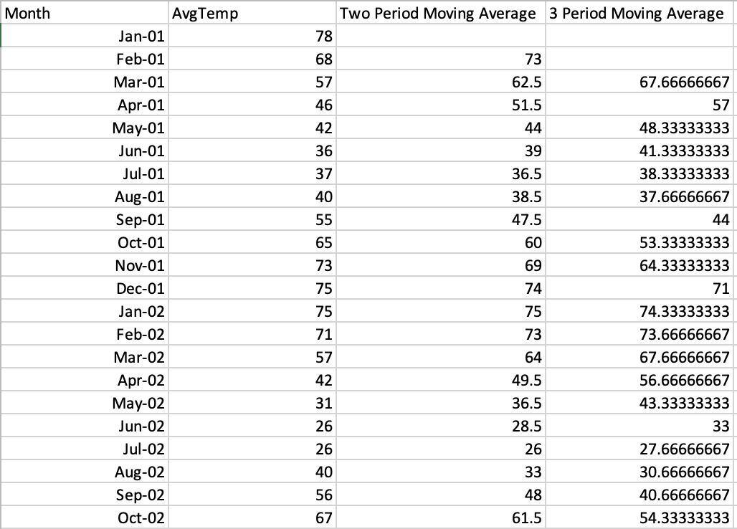
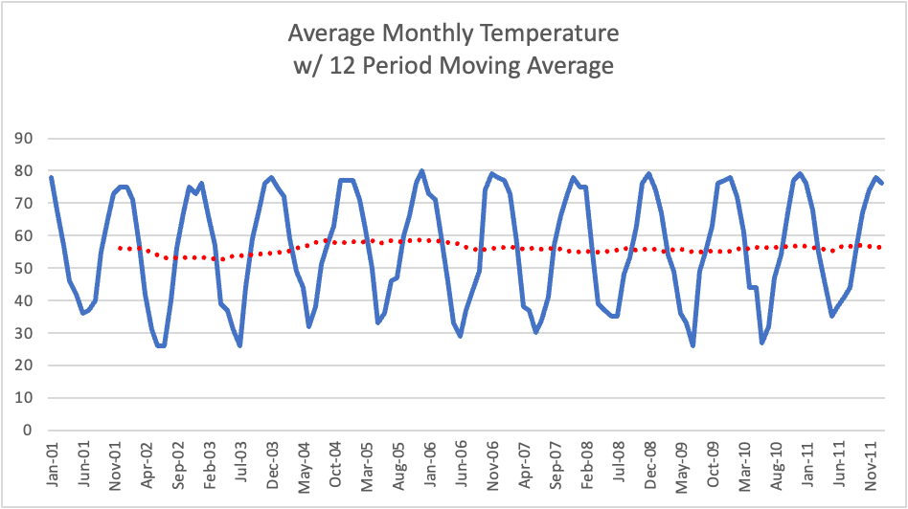
Smoothing Methods - Moving Averages
Moving Average: A succession of averages derived from successive segments of values, typically overlapping and equal length
Used to reveal underlying trends / remove seasonal / cyclical patterns
Also used for baseline forecasting
MA2 = Y = (Yt + Yt-1) / 2
MA3 = Y = (Yt + Yt-1 + Yt-2) / 3
And so on…

Slide 7
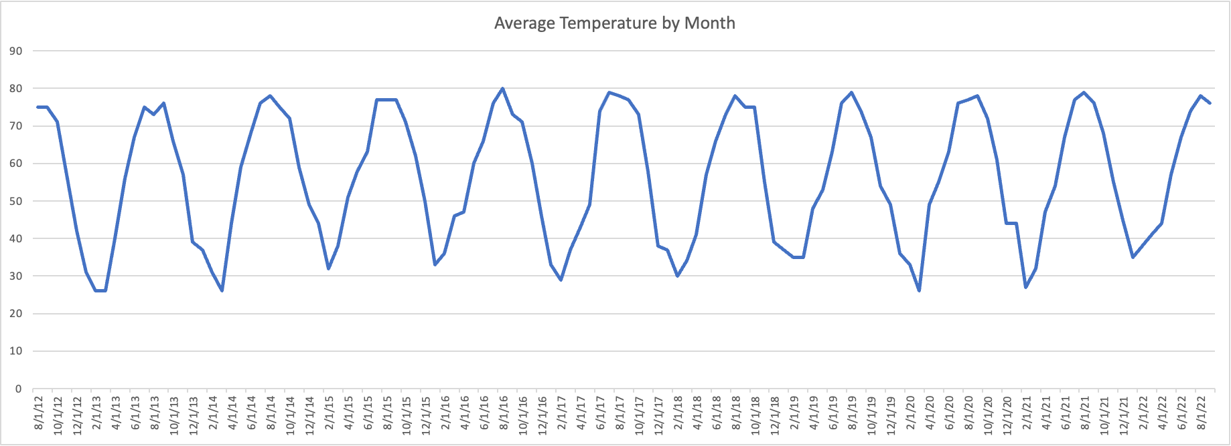
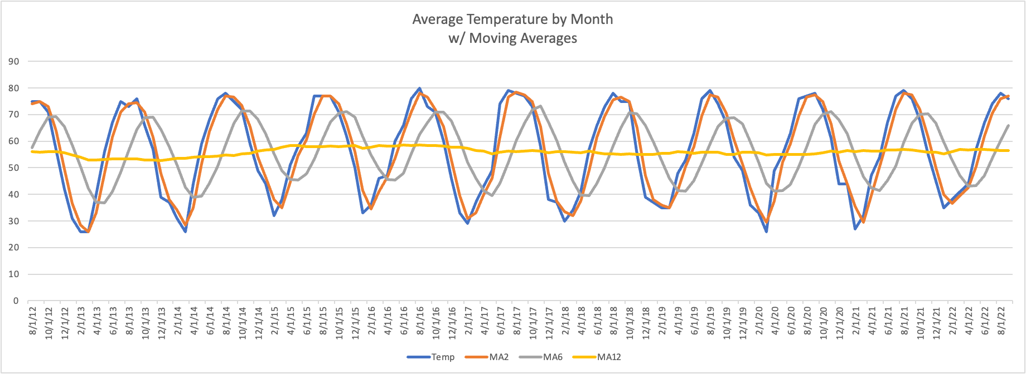

Slide 8
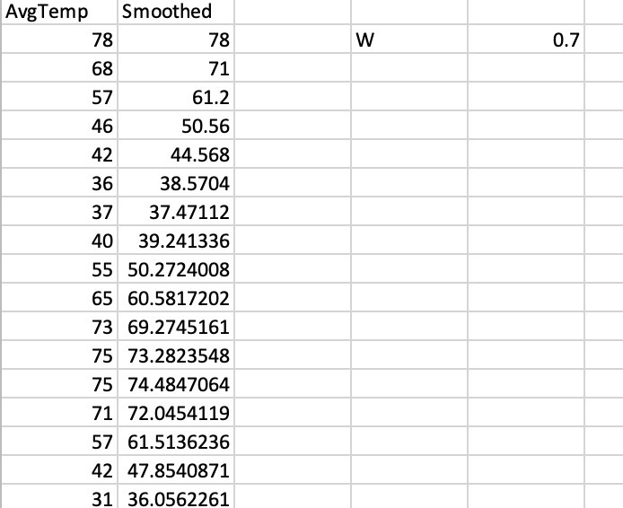
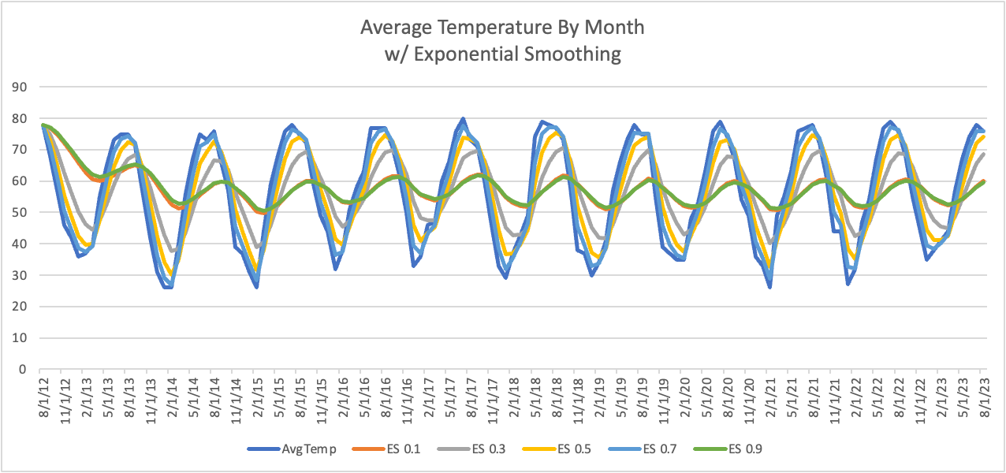
Smoothing Methods - Simple Exponential Smoothing
Essentially a weighted moving average
E1 = Y1
Et = WYt + (1-W)Et-1
W ranges from 0 to 1 and is selected subjectively.
Smaller W = Slower reaction to new info, more smoothing
Larger W = Faster reaction to new info
Yi+1 = Ei for forecasting one period ahead
(Use Holt's Linear Trend Method to add a trend and Holt-Winters Exponential Smoothing to add trend and seasonality)
Simple exponential smoothing is for no strong trend and no strong seasonality

Slide 9
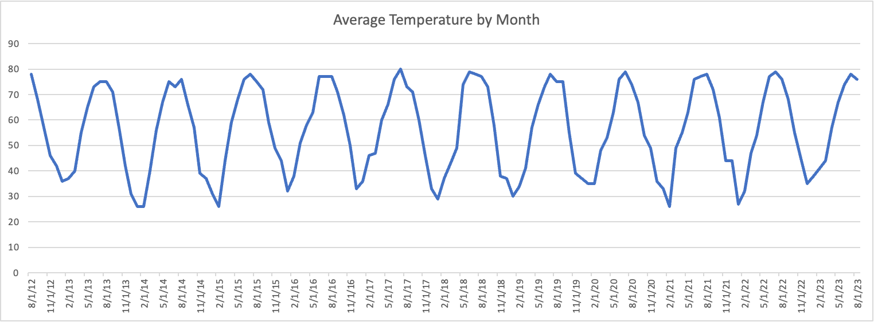
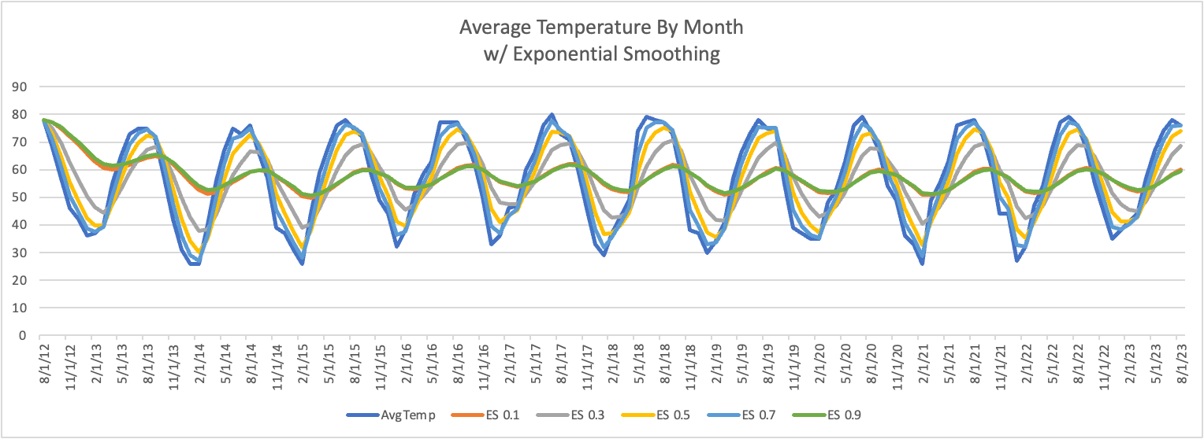

Slide 10
Moving Average vs Exponential Smoothing
Use MA when you’re looking to smooth out short-term fluctuations and there’s no strong trend
Strengths:
Simple to calculate and explain
Weaknesses:
All data is equally weighted
Use ES when recent observations matter, there’s no strong trend (simple ES), and/or you want a one-step-ahead forecast
Strengths:
More responsive to change than MA
Good for one-period forecast
Weaknesses:
Harder to compute
Must select tuning parameter (0 to 1)

Slide 11
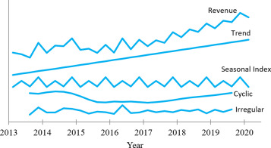
Time Series Components
Trend: The long term progression of a series that excludes short term fluctuations
Seasonality: Fluctuations that repeat over a specific period - regular
Cycle: Fluctuations that do not repeat over a specific period - irregular
Noise / Error / Random: Fluctuations in the data that occur after trend, seasonality, and cyclical factors are accounted for
Splitting apart these components is often referred to as decomposition
Not every series has all four components

Slide 12
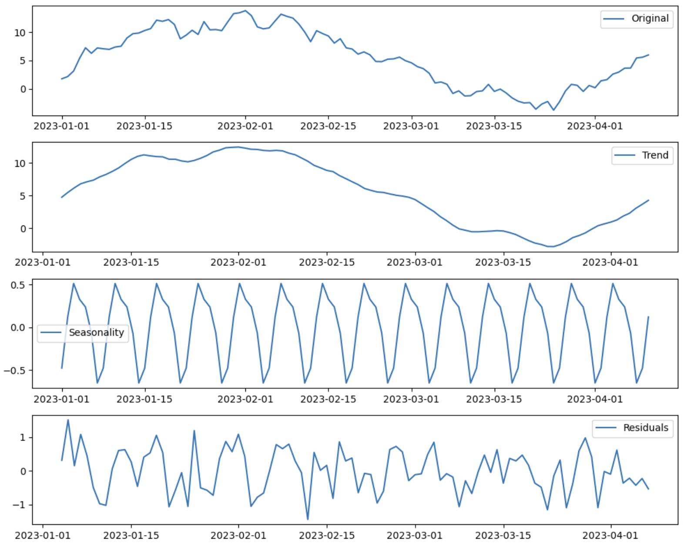
Decomposition (Additive)
Y = T + S + E
T = MA that smooths out the seasonality
Y - T = S + E
S = Average values for “seasons” (or months or days)
(Y - T) - S = E
Or just use software

Slide 13
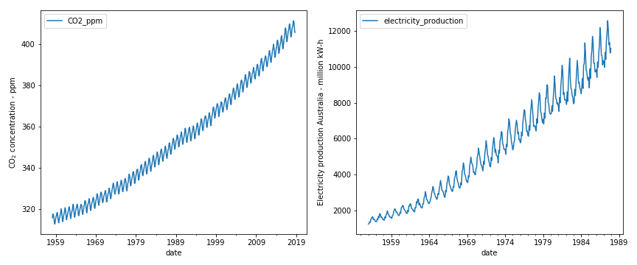
Decomposition
Components are either additive or multiplicative
Additive: Y = T + S + E
Multiplicative Y = T x S x E
(= log(Y) = log(T) + log(S) + log(E))
Multiplicative if magnitude of seasonality varies with level of the series or trend

Slide 14
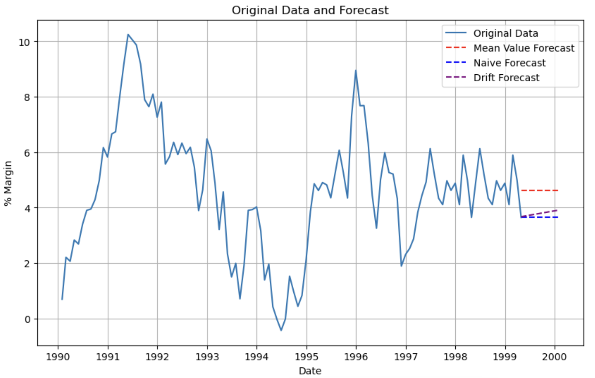
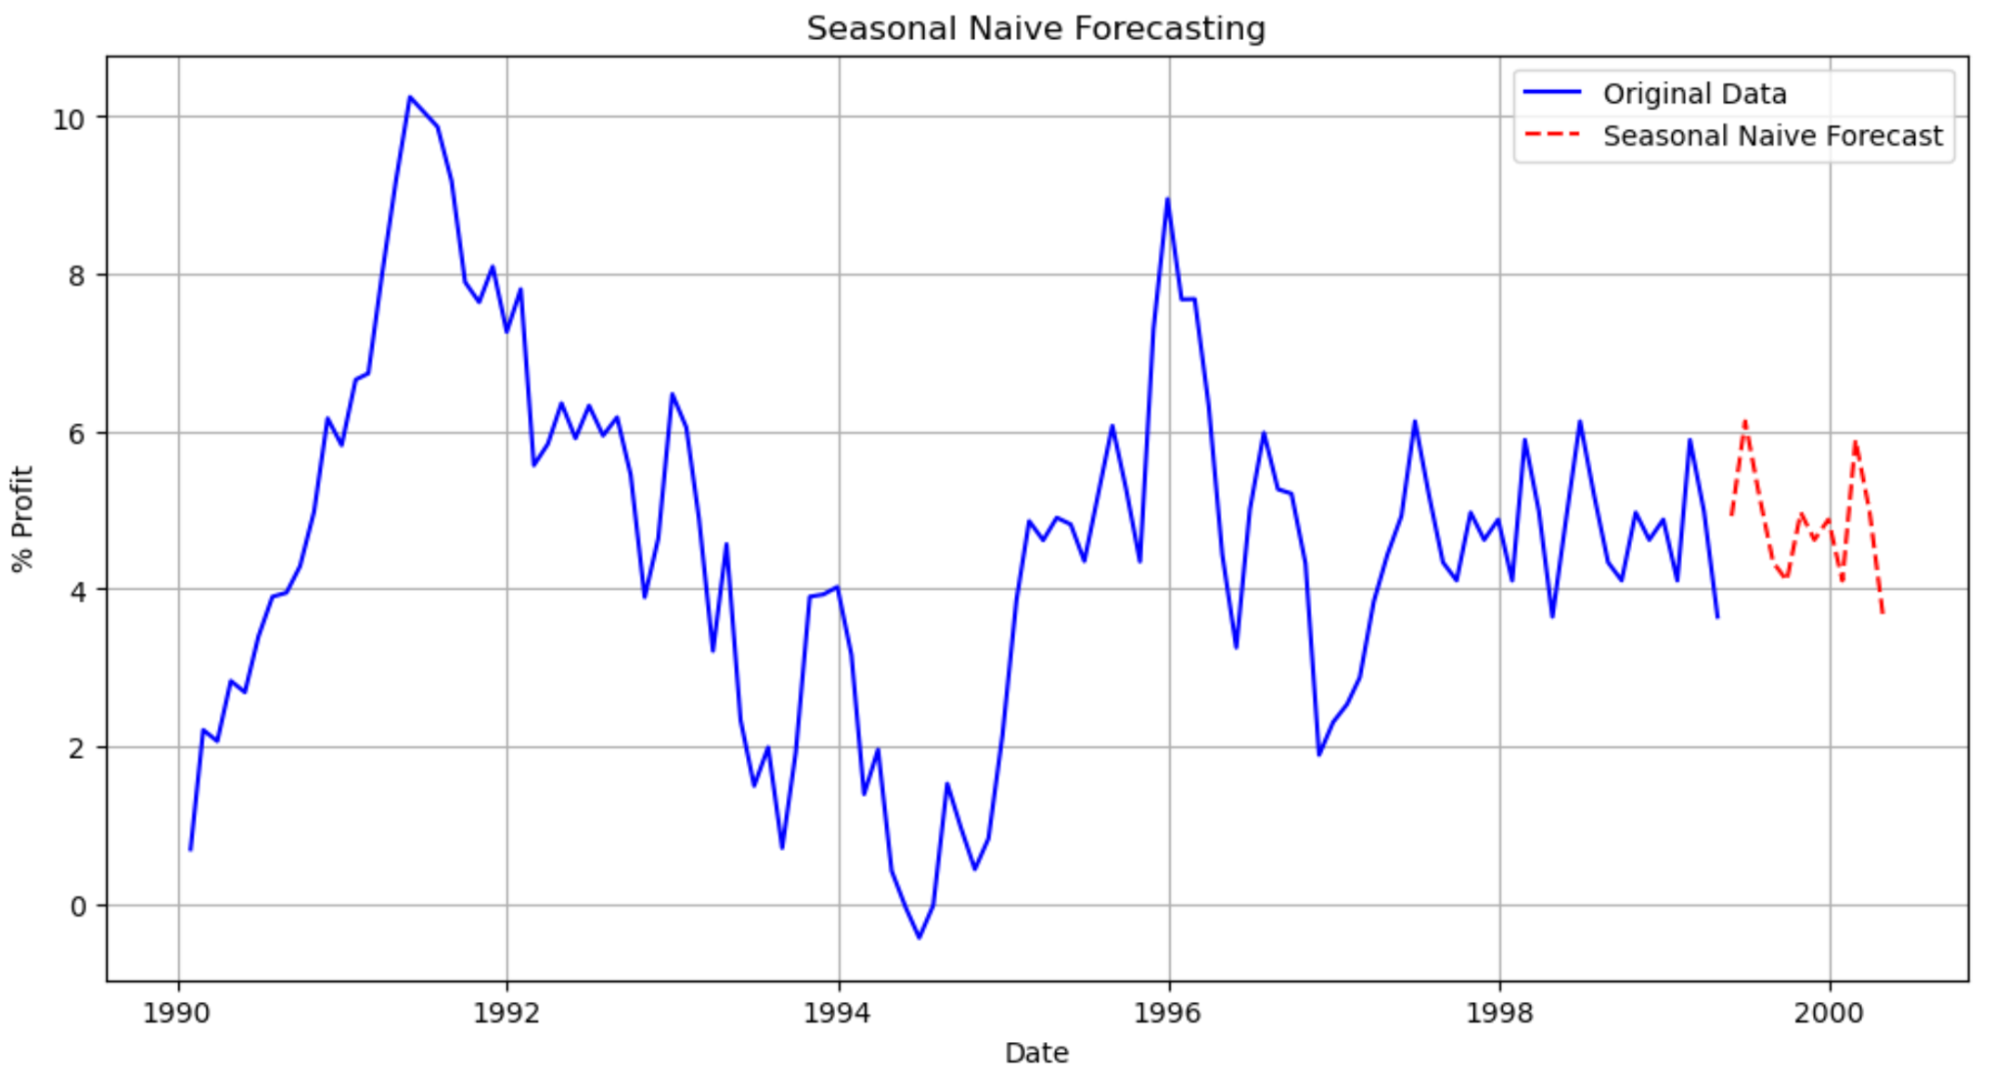
Baseline Forecasting Methods
Mean Value: Expect that future values will equal the mean value of the series - Use with stable data
Naive: Expect that future values will equal the last recorded value of the series - Use with random walk
Seasonal Naive: Expect that future values will equal the last recorded value of the series from the same season (quarter, month, etc.) - Use with strong seasonality
Drift: Expect that slope between first and last point in the series can will continue into the future
Often a good idea to compare complex methods to baseline methods

Slide 15
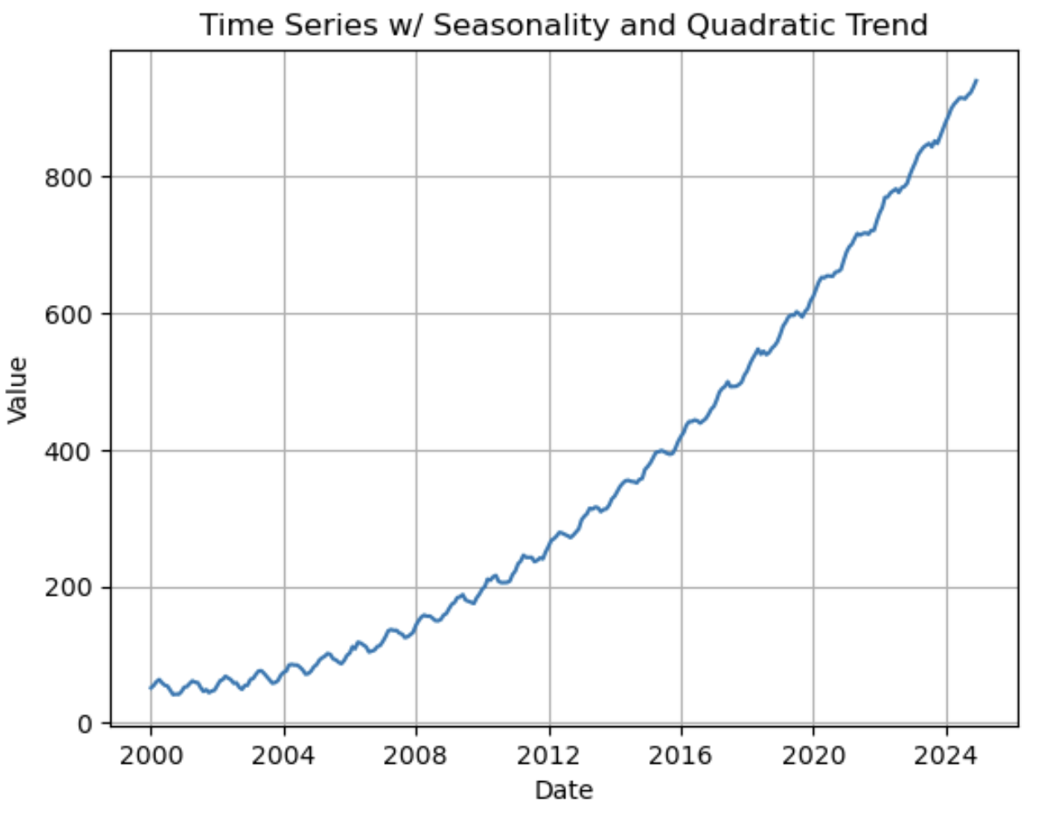
Simple Regression Forecasting
Linear Model:
Y = B0 + B1(T) + E
Quadratic Model:
Y = B0 + B1(T) + B2(T^2) + E
Exponential Model:
Y = B0*(B1^T)*E
T = Time Index (0, 1, 2, 3…)
Note: These are trend models, not full time-series models

Slide 16
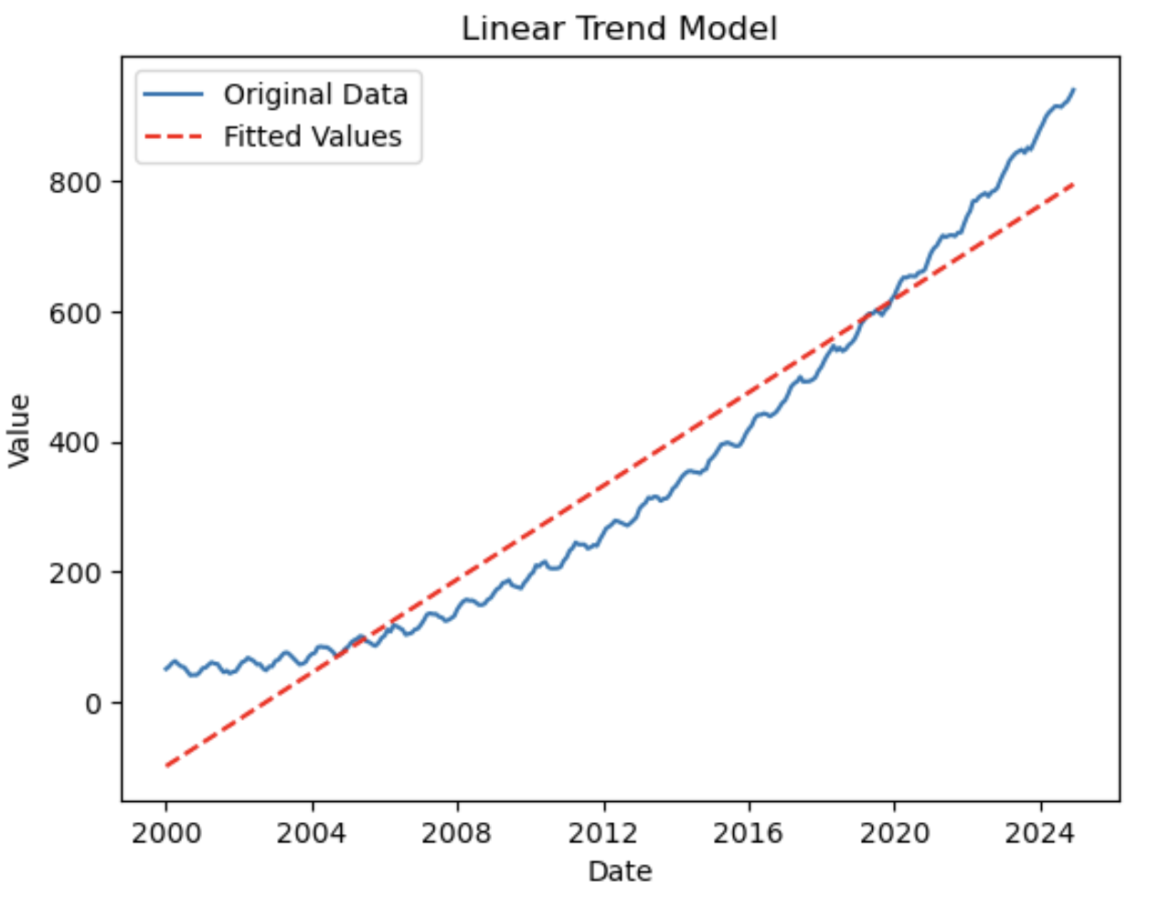
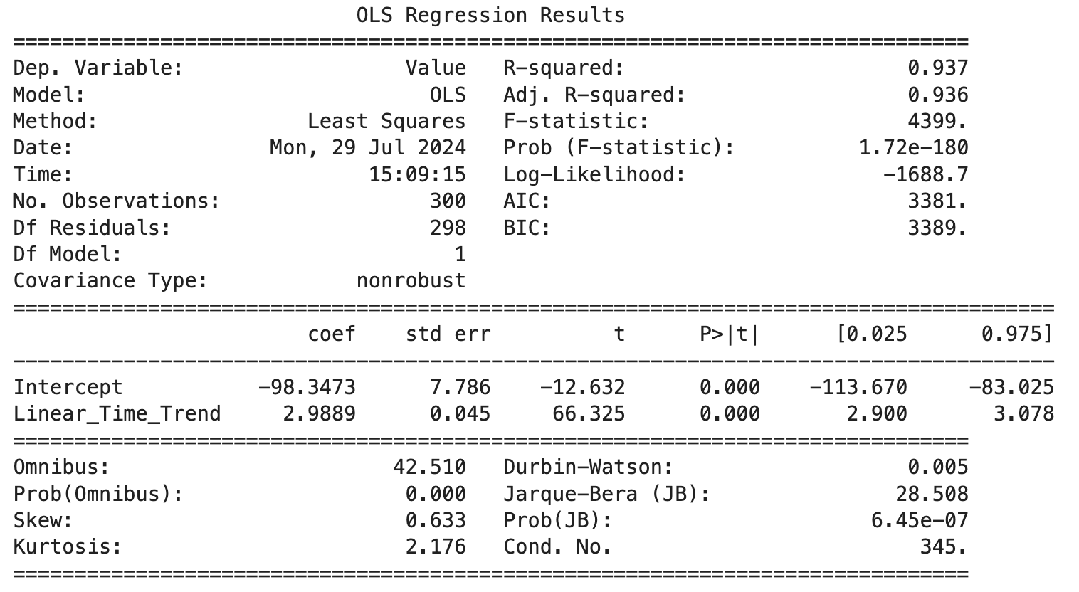
Linear Model
Y = B0 + B1(T) + E
Create a time/index variable that begins at zero and increases by one for each time period (0, 1, 2, 3…)
Run OLS regression with the time/index variable as one of your independent variables
Works poorly if seasonality or autocorrelation is strong

Slide 17
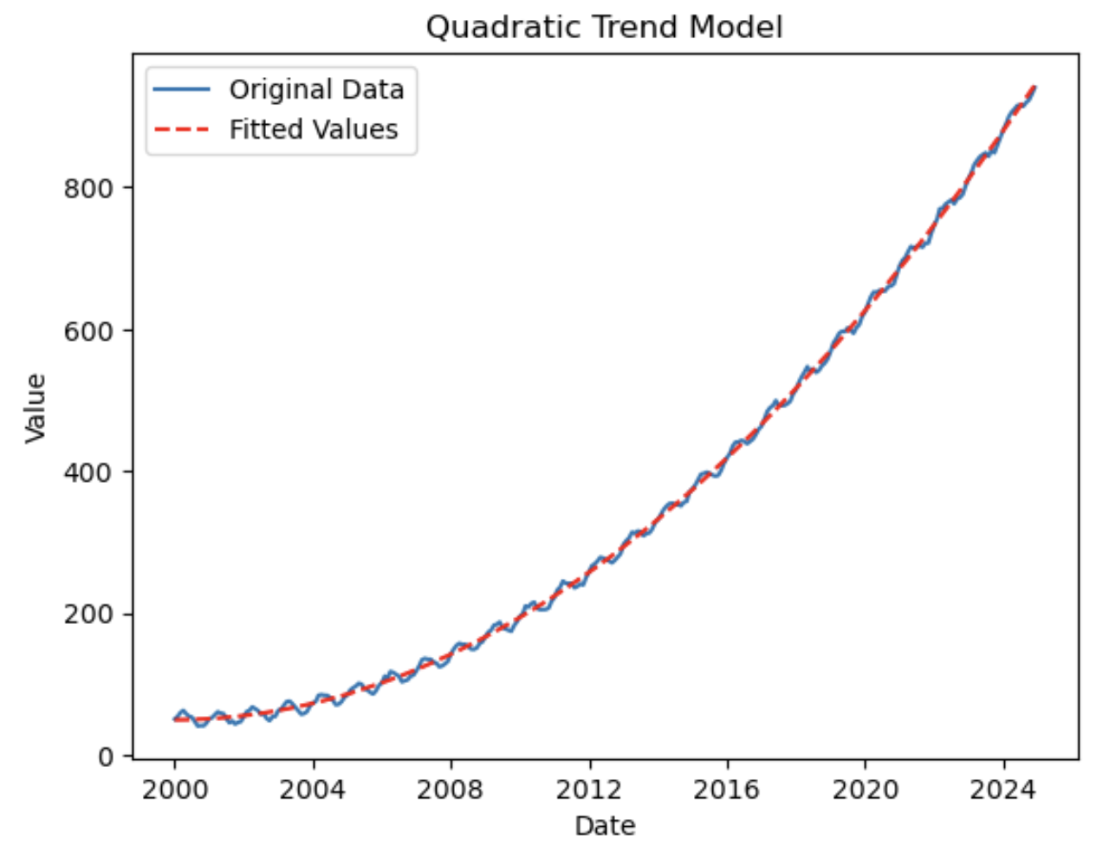
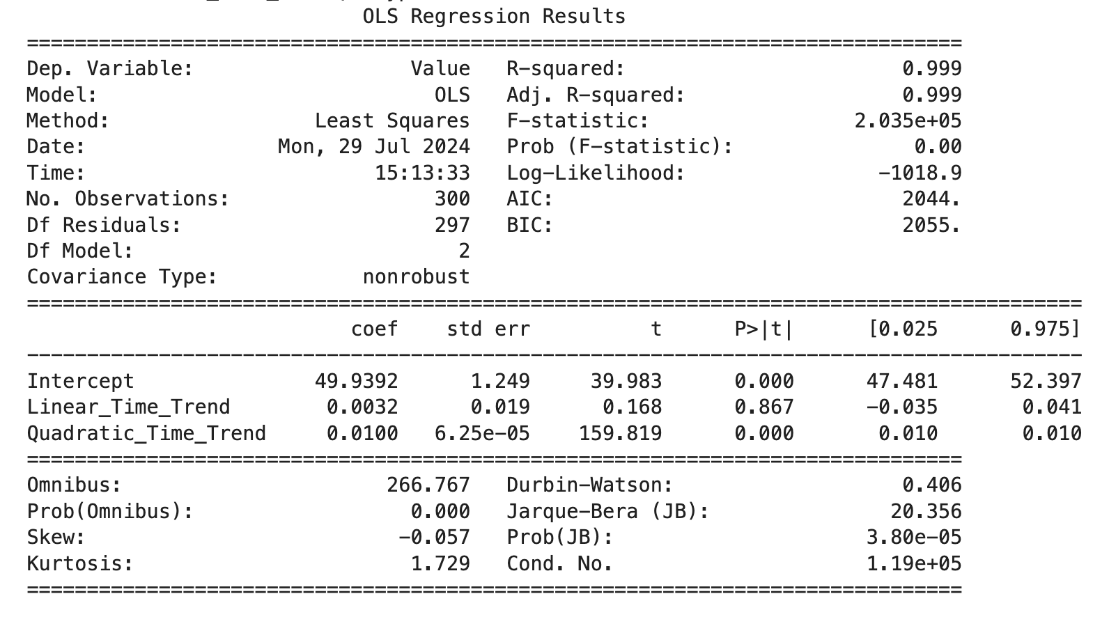
Quadratic Model
Y = B0 + B1(T) + B2(T^2) + E
Create a time/index variable that begins at zero and increases by one for each time period (0, 1, 2, 3…)
Create another variable that is the squared values of the time/index variable.
Run OLS regression with the time index and squared time index both included as independent variables
Captures curvature, acceleration / deceleration over time

Slide 18
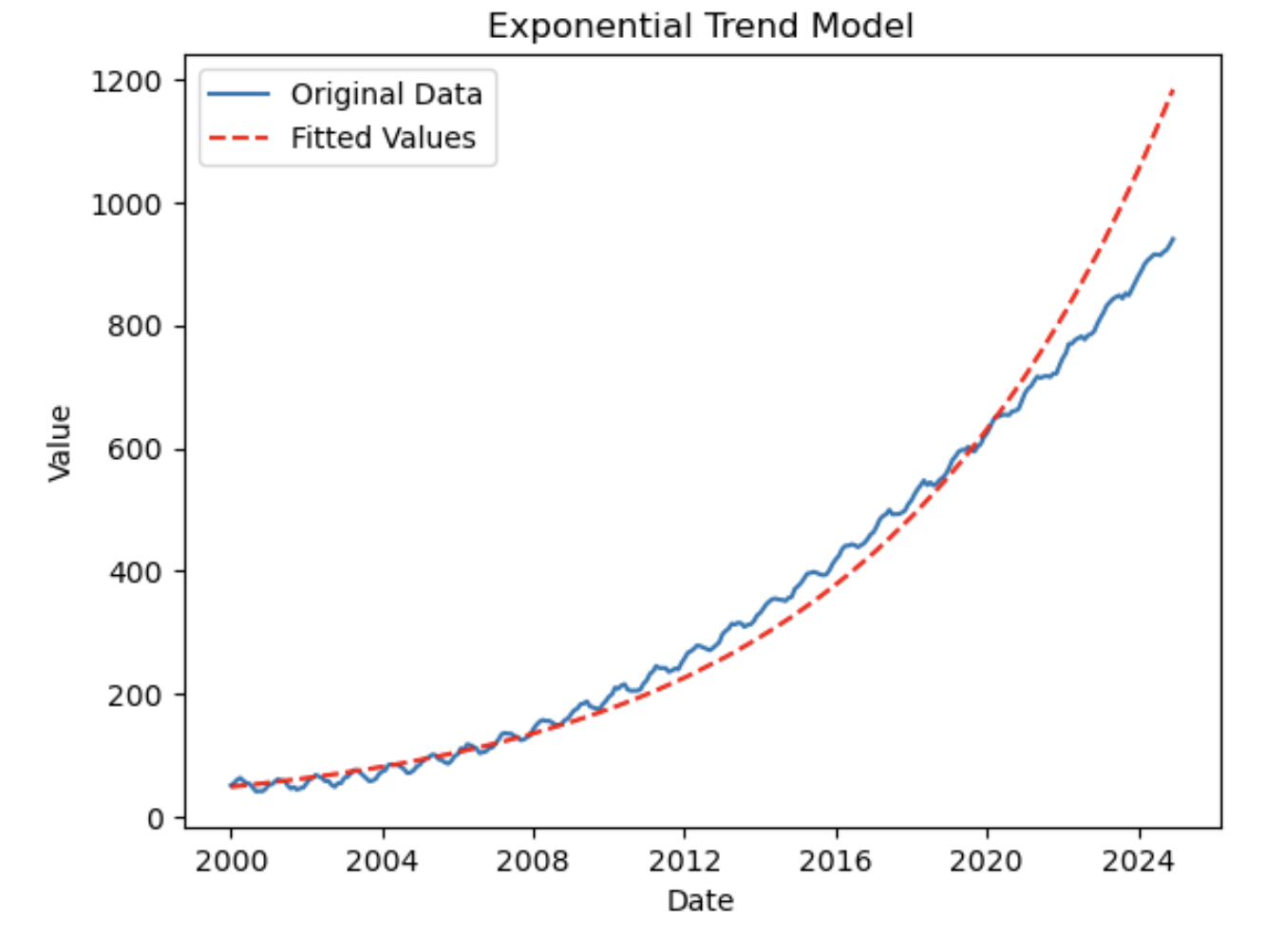

Exponential Model
Y = B0*(B1^T)*E
Not directly linear, but can be linearized with logs
Recall that ln(x^y) = y*ln(x), and transform original equation
ln(Y) = ln(B0) + ln(B1)*T + ln(E)
Useful when growth is compounding

Slide 19
Periodic Dummy Variables
As discussed before, we can use dummy variables to capture seasonality
# of dummies = # of categories - 1
3 dummies for quarterly seasonality, 11 for monthly seasonality, etc.
The omitted category is the baseline
Y = B0 + B1(Q1) + B2(Q2) + B3(Q3) + E … Baseline = Q4
Y = B0 + B1(Q2) + B2(Q3) + B3(Q4) + E … Baseline = Q1
Each dummy coefficient is the seasonal difference relative to the omitted baseline period
Just don’t do Y = B0 + B1(Q1) + B2(Q2) + B3(Q3) + B4(Q4) + E because that would cause PERFECT MULTICOLLINEARITY

Slide 20
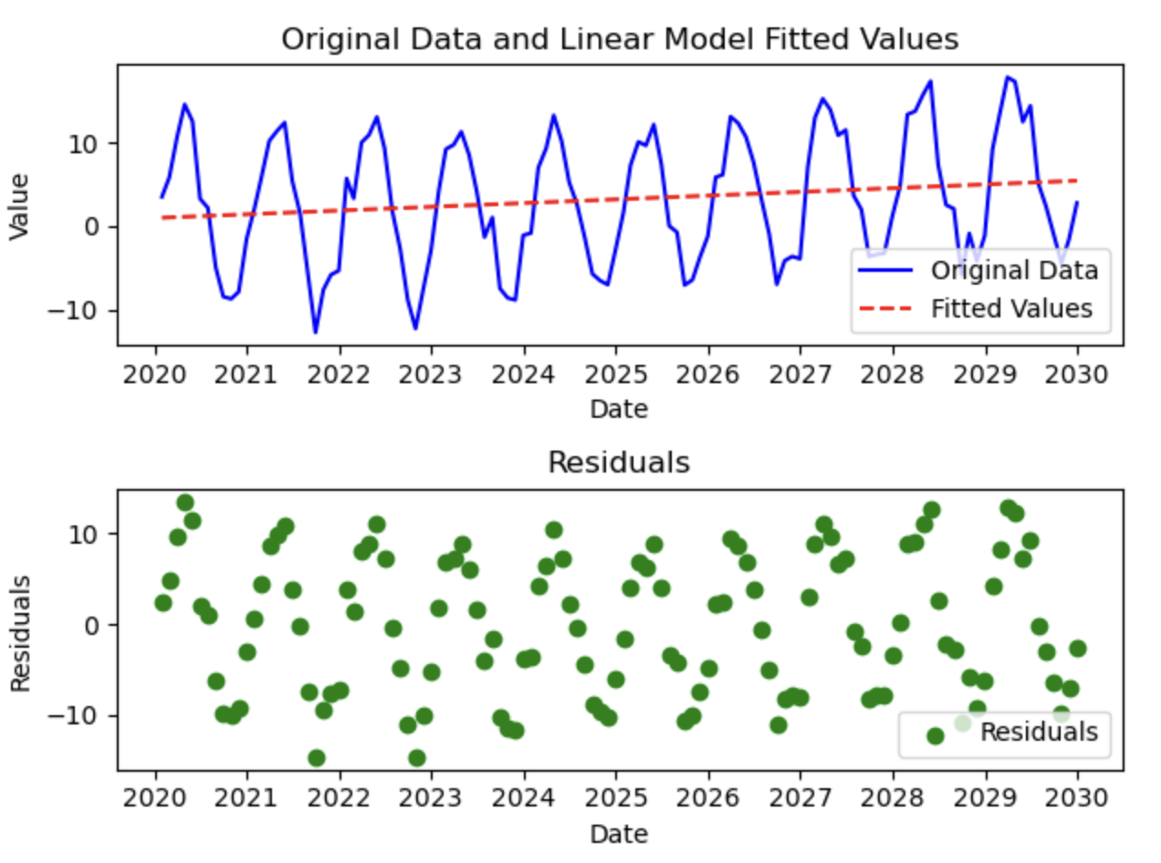
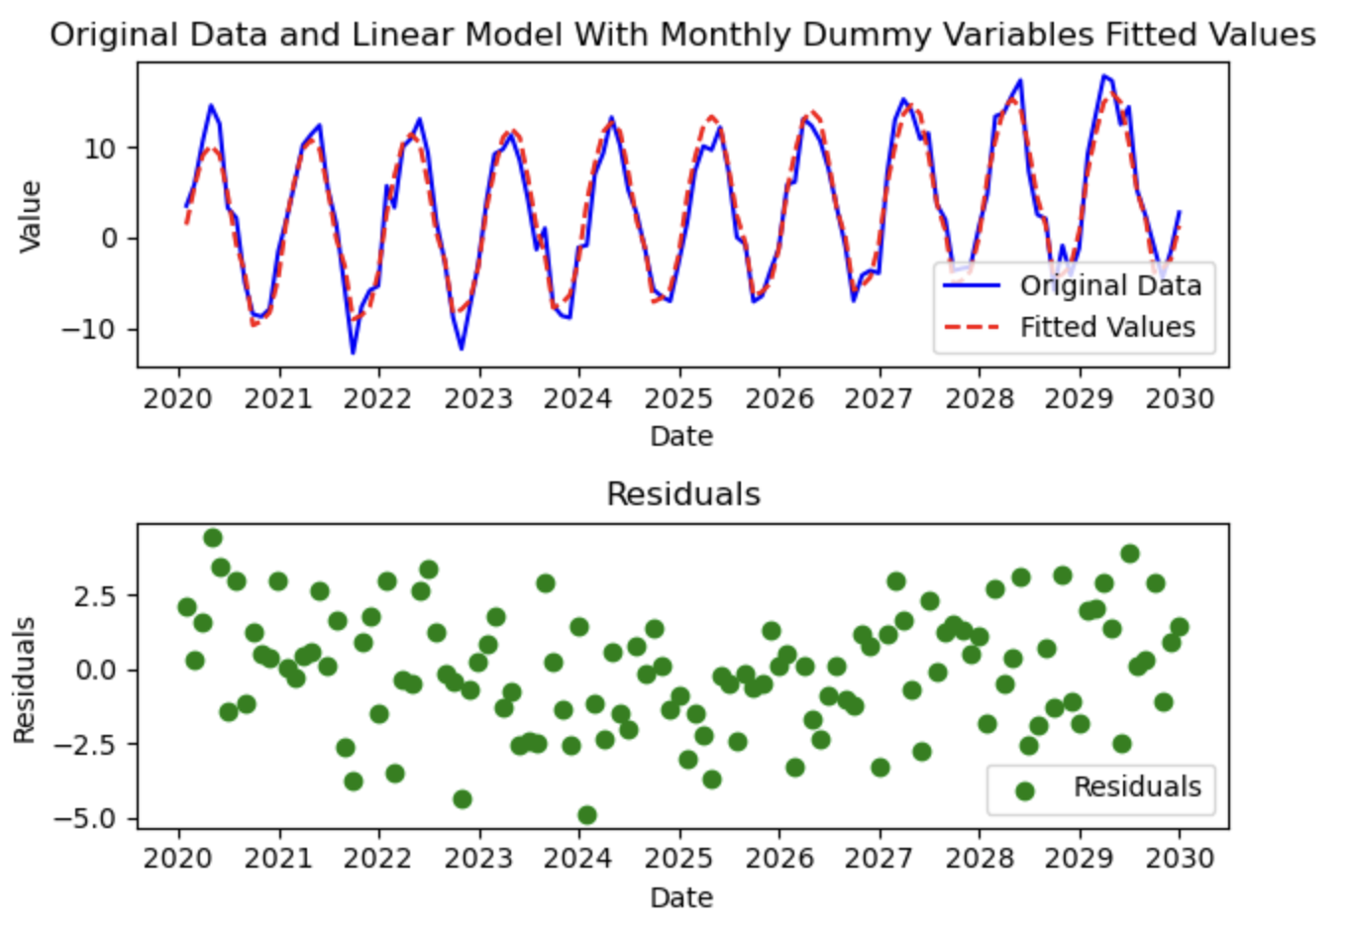
Modeling Seasonality With Dummy Variables

Slide 21
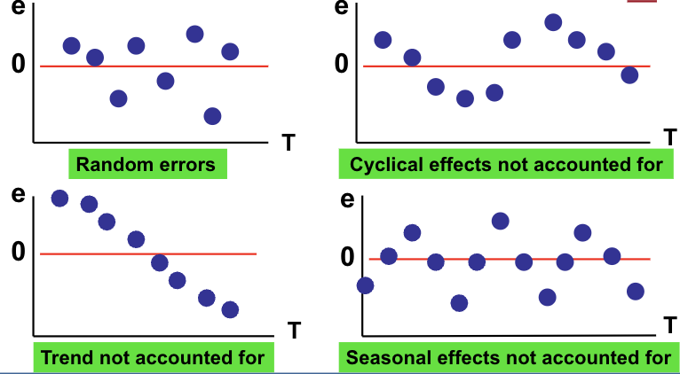
Time Series Residual Patterns
Plotting residuals against the time index will often reveal unaddressed patterns in the data and is a vital step in time series analysis

Slide 22
Lagged Variables in Regression Models
Shift variable down on spreadsheet to create a lagged variable
Causes a loss of one observation
Coefficient on lagged variable is the impact of X at the prior time period on Y (holding other included variables constant)
Y | X | X(T-1)
240 | 15 | NA
288 | 19 | 15
274 | 18 | 19
220 | 14 | 18

Slide 23
Generalized Least Squares for Autocorrelated Residuals
If there’s significant autocorrelation, standard errors are inflated, hypothesis testing and confidence intervals are no longer reliable
This problem is indicated by failing the Durbin-Watson test (<1.5 or > 2.5)
GLS uses Cochrane-Orcutt or Prais-Winsten iterative procedure to estimate the autocorrelation structure
Yt = B0 + B1(Xt) = Et, but
Et = 0.5(Et-1) + Ut
GLS transforms the data
Y*t = Yt - 0.5(Yt-1) and X*t = Xt -0.5(Xt-1)
Then running
Y*t = B0(1-0.5) + B1(X*t) + Ut
Produces valid results

Slide 24
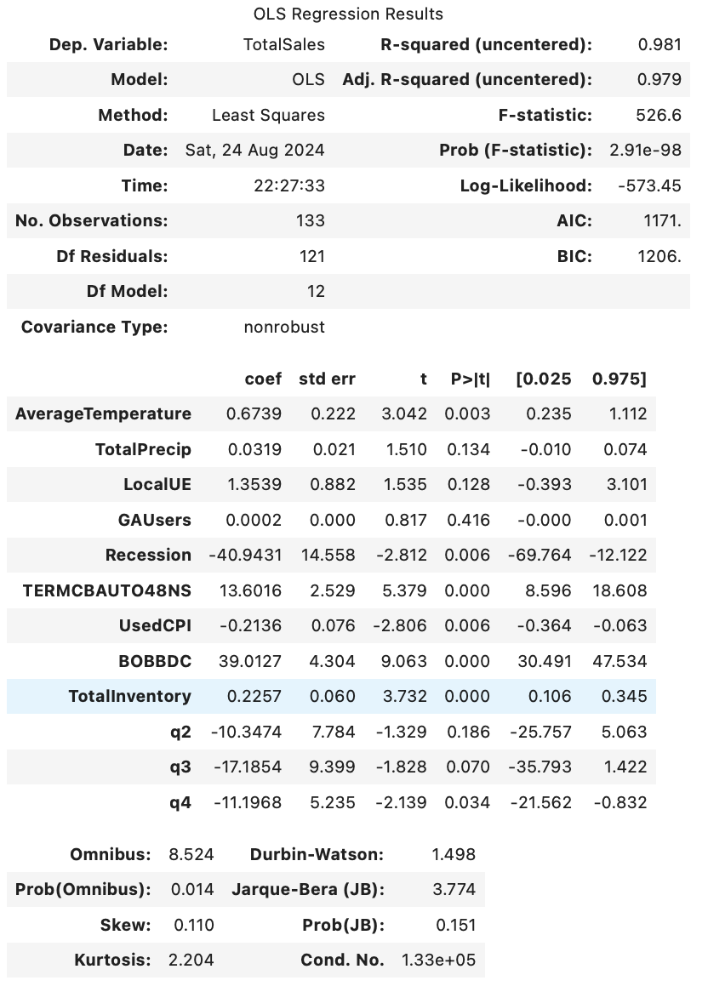
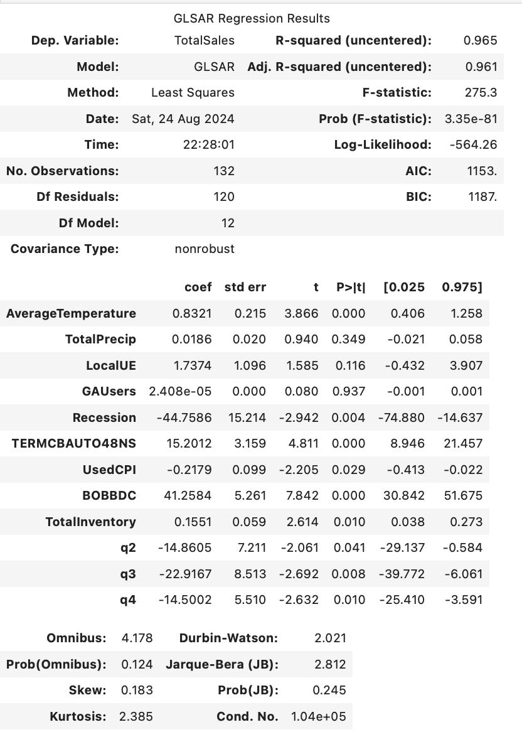

Slide 25
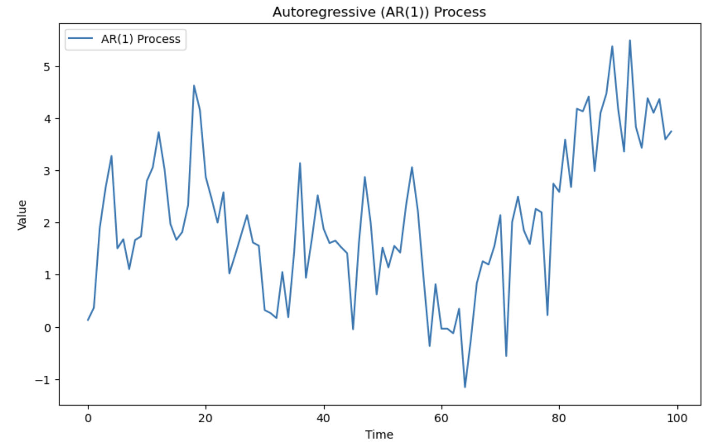
Univariate Time Series Models - Autoregressive Models
Autoregressive models explain Y in terms of past values of Y
Intuition: Today depends on yesterday
AR(n): Yt = B0 + B1(Yt-1) + B2(Yt-2) + … Bn(Yt-n)
Good to use when series is “self-predictive” and recent values carry most information about next values

Slide 26
Univariate Time Series Models - Autoregressive Models
Autoregressive models explain Y in terms of past values of Y
AR(n): Yt = B0 + B1(Yt-1) + B2(Yt-2) + … Bn(Yt-n)
Assumptions:
1) Stationarity
2) Appropriate lag structure*
3) Residuals are white noise
4) No major missing observations
5) Linear dependence in lagged values
Seasonality calls for adjustments

Slide 27
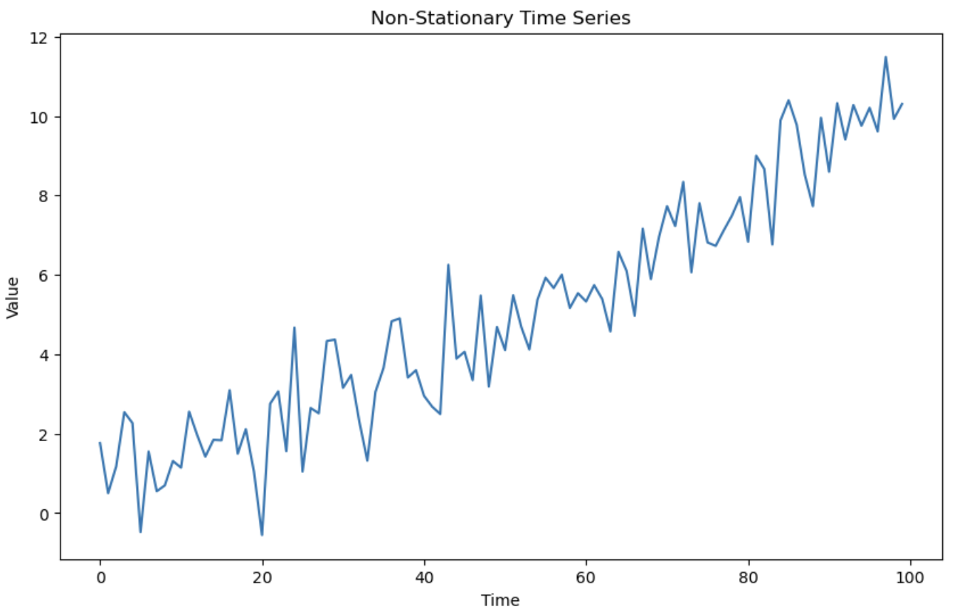
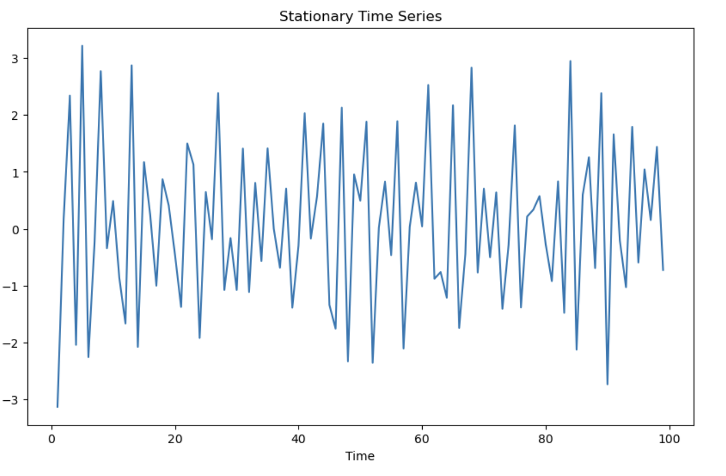
Stationary vs Non-Stationary Data
Stationary data has a constant mean and variance.
Often stationarity is required for proper forecasting.
Unstable mean/trend can create misleading models, spurious relationships
Use Augmented Dickey Fuller test to test for stationarity
H0: Non-Stationary, HA: Stationary
If p-value < alpha, reject the null that the data are non-stationary / conclude that the data probably are stationary
Non-stationary data can be made stationary using “differencing”*
If transformed to create stationary data, interpretation of model results may change.

Slide 28
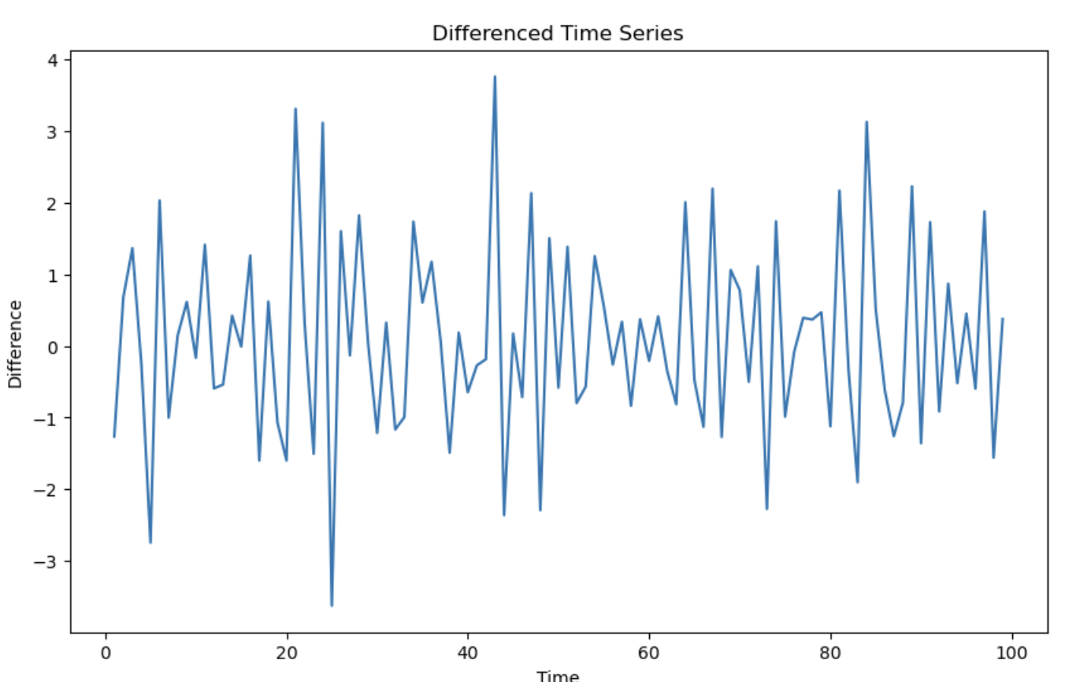
Differencing
Differencing: Transforming values in a time series by subtracting the prior value(s)
Used to make non-stationary data stationary
Interpretation of models may change*
Differenced models explain changes, not levels
First difference of Yt = Yt - Yt-1
Second difference of Yt = (Yt - Yt-1) - (Yt-1 - Yt-2)

Slide 29
AR Model Steps
Plot the series and inspect for trends, seasonality, and outliers
Inspect PACF plot to see how past values influence future ones
Check for stationarity with ADF test - Difference if necessary
Determine lag order with PACF (and/or auto-fitting via AIC/BIC)
Fit the model
Plot residuals and/or run Ljung-Box test to see that residuals are white noise
Forecast

Slide 30
AR Model Diagnostics
Residuals must be white noise (random)
Look for significant spikes in ACF and PACF plots of residuals (beyond lag 0)
If spikes are found, more lags or a different model may be needed
Ljung-Box Test for autocorrelation of residuals
H0: No autocorrelation, HA: Autocorrelation
If p > 0.05 (alpha), we fail to reject H0 and conclude residuals appear random
If p < 0.05, we reject H0 and conclude residuals appear correlated

Slide 31
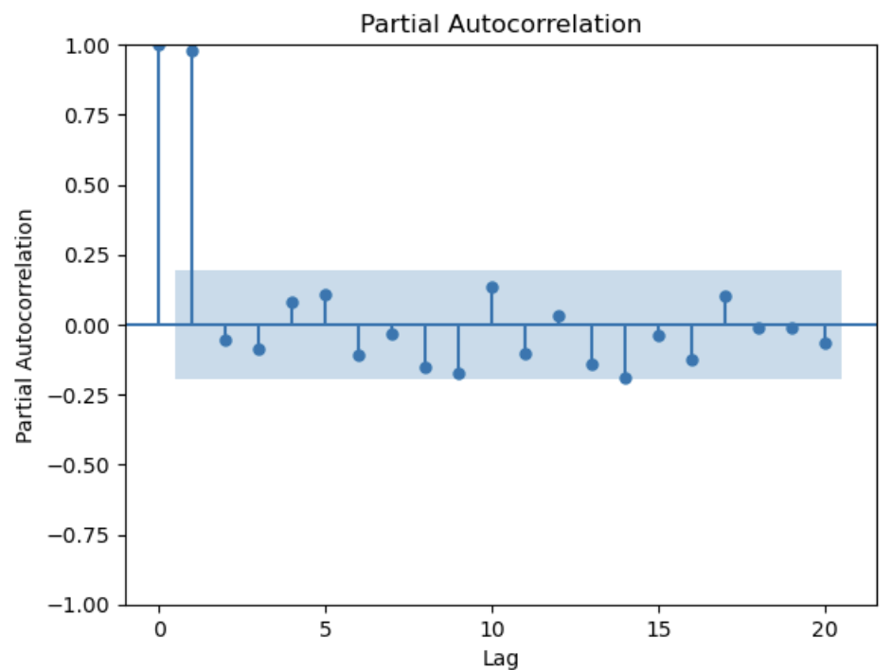
Partial Autocorrelation Function Plot (PACF)
A PACF plot is a bar chart of the partial correlation coefficient between a time series and its lagged values, controlling for the impact of all shorter lag values
A value of 0.75 when lag is 10 means the correlation coefficient between the series and its value 10 periods prior is 75%, after controlling for the impact of the dependent variable at lags of 1 through 9
Spikes outside confidence bounds indicate significant lags
Sharp cutoff after lag p suggests AR(p)

Slide 32
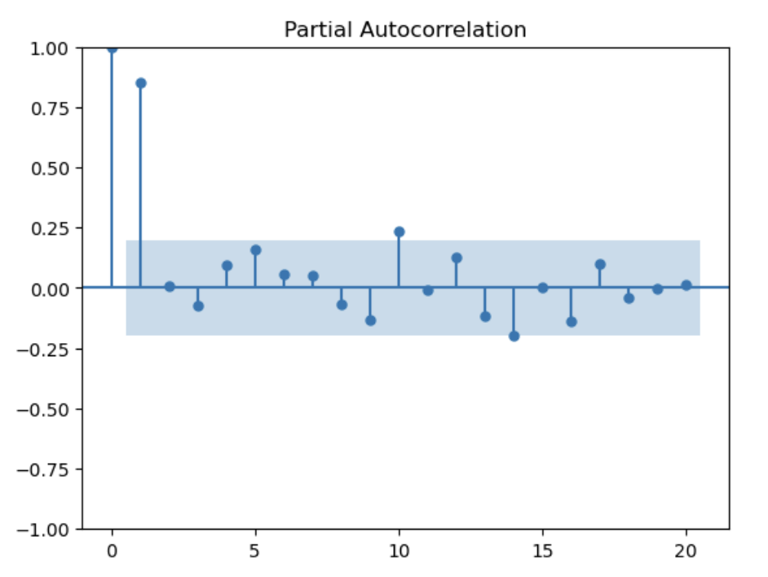
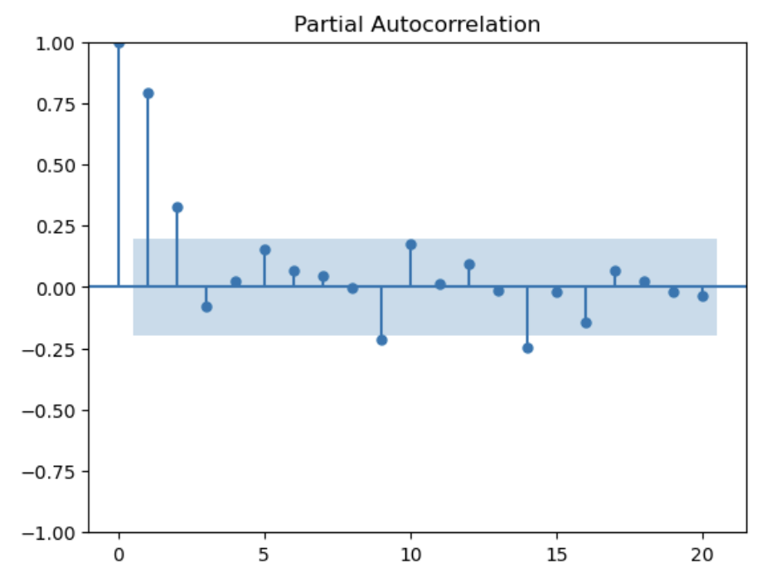
Selecting AR Lag Order
PACF suggests candidate lag structures
AIC/BIC compare candidates
Residuals validate candidates

Slide 33
Univariate Time Series Models - Moving Average Models
Moving average models explain Y in terms of past forecast errors and shocks
MA(n): Yt = Mean + et + B1(et-1) + B2(et-2) + … Bn(et-n)
Assumptions:
1) Stationarity
2) Finite Order - Lagged errors beyond specified order do not influence current values
3) No missing values
4) Well behaved errors*
5) Linearity*

Slide 34
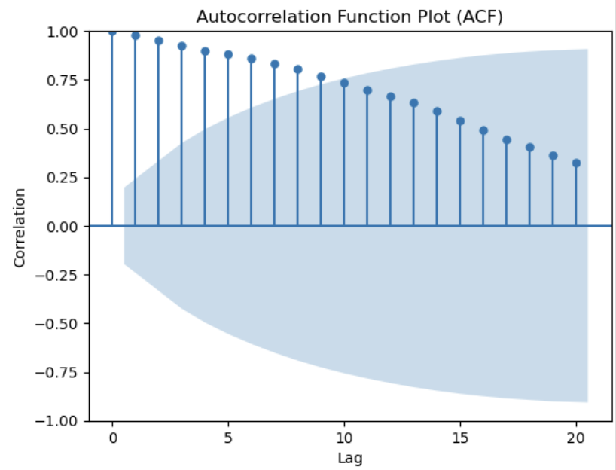
Autocorrelation Function Plot (ACF)
ACF helps identify likely MA order
Sharp cutoff after lag q suggests MA(q)
An ACF plot is a bar chart of the correlation coefficients between a time series and its lagged values
A value of 0.75 when lag is 10 means the correlation coefficient between the series and its value 10 periods prior is 75%

Slide 35
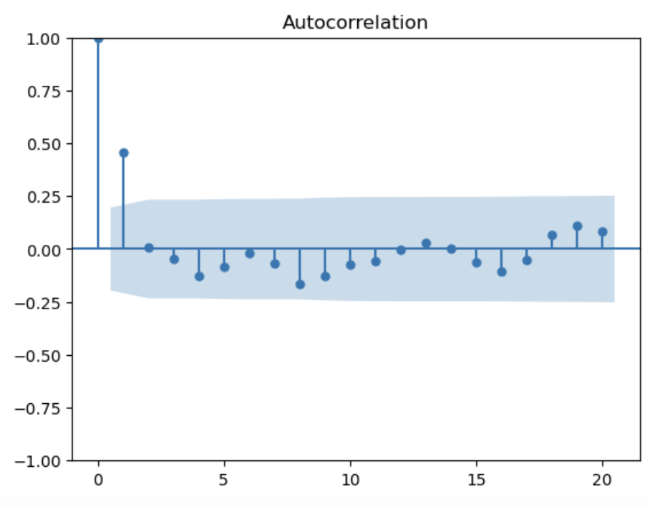
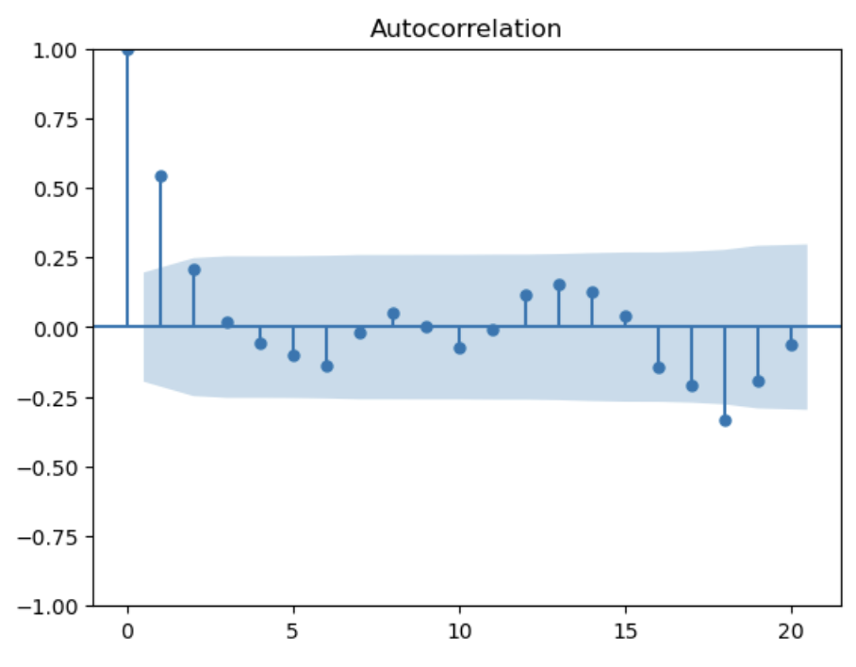
Selecting MA Lag Order
Check ACF plots (vs PACF for AR)
Compare AIC and BIC for models with different lag structures (lower is better)
Check fitted values vs residual plots

Slide 36
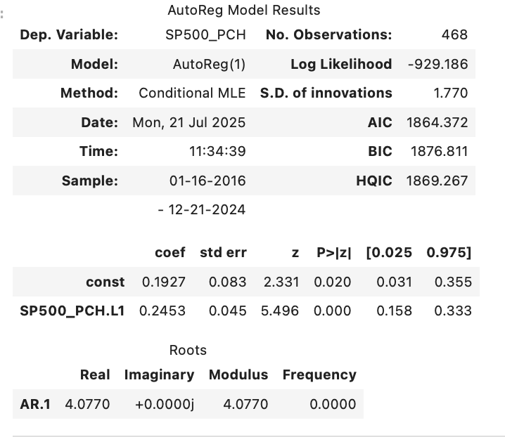
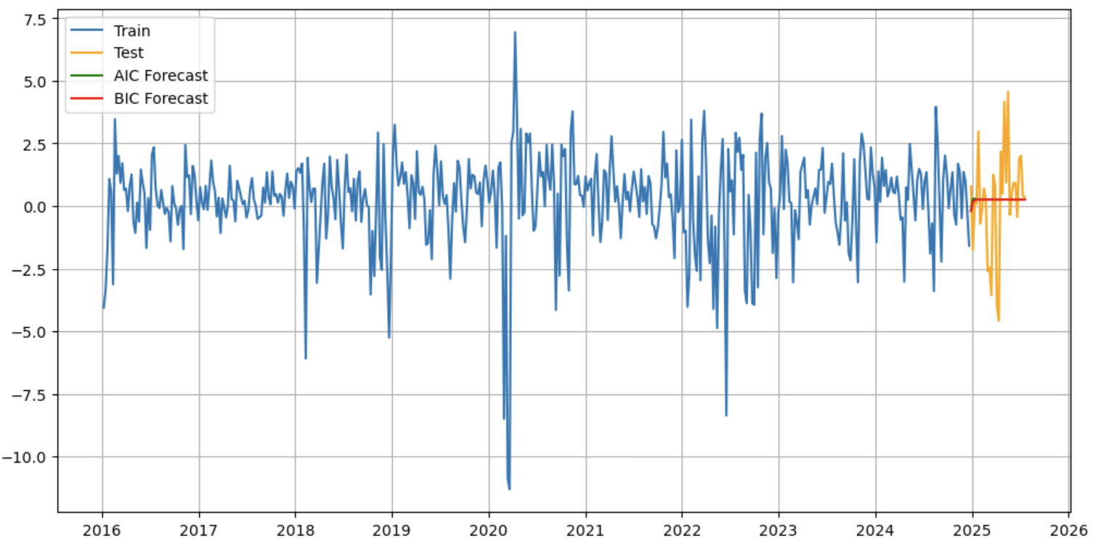
Forecasting with AR and MA Models
Plug (rolling) values into coefficients or use software to do it for you!

Slide 37
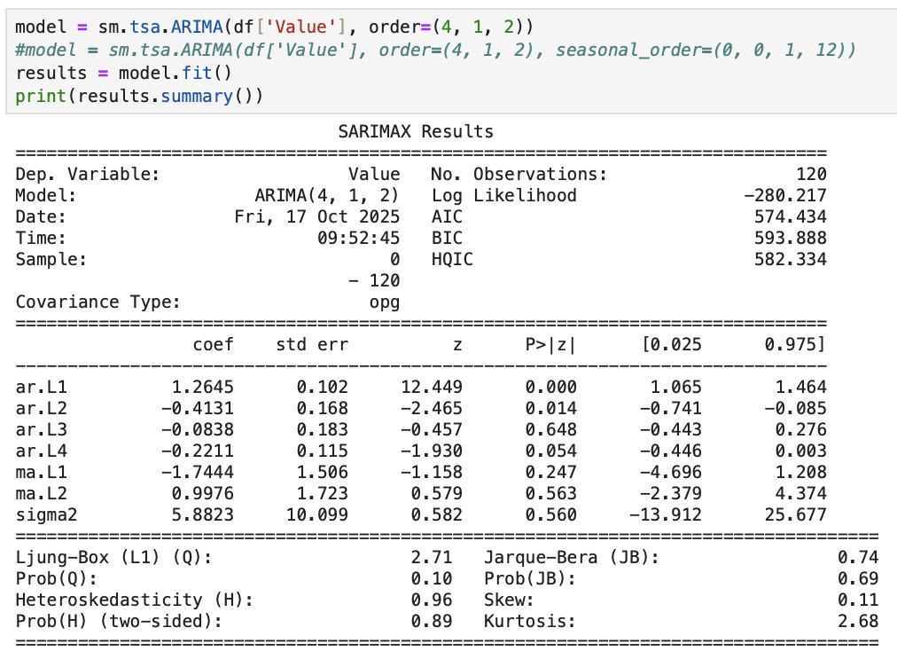
ARMA and ARIMA
ARMA = AR + MA
ARIMA = AR + Differencing + MA
ARIMA is a widely used general-purpose forecasting model
ARIMA (p, d, q)
p = autoregressive term
d = differencing term
q = moving average term
ARIMA requires stationarity but differencing term accounts for it

Slide 38
ARIMA Assumptions
Stationarity (Solved by differencing or transformation)
Linearity*
No autocorrelation of residuals - Should be “white noise”
Homoskedastic errors
Normality of residuals (for inference only)
Check residuals with Ljung-Box - p-value > 0.05 = white noise
and/or
Check ACF/PACF of residuals

Slide 39
ARIMA Interpretation - AR
AR coefficients:
Positive = Momentum = High values follow high values
Negative = Oscillation = High values follow low values
Near 1 = Persistent
Near 0 = Weak serial dependence
arL1 = 0.6 means 60% of the last period’s deviation carries into this period

Slide 40
ARIMA Interpretation - MA
MA coefficients:
Positive = The effect of a positive shock persists into next period
Negative = The effect of a positive shock reverses in next period

Slide 41
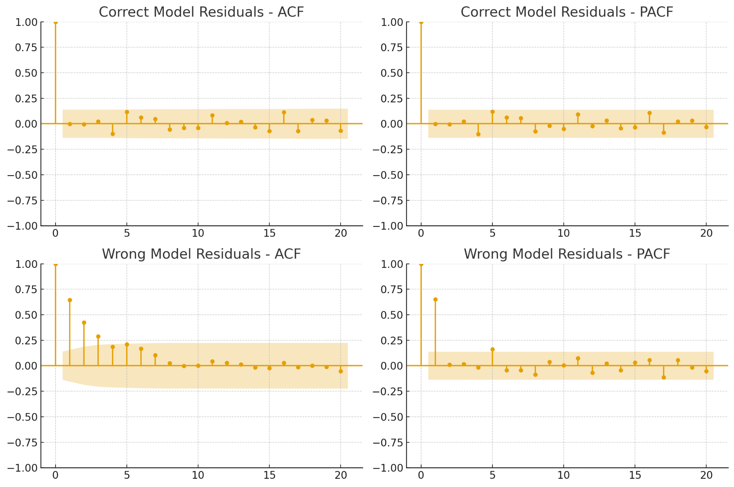

Slide 42
ARIMA Extensions
Extensions:
SARIMA = Seasonal ARIMA (ARIMA but with seasonality)
ARIMAX = ARIMA + Exogenous Variables (ARIMA but with other X variables)
https://github.com/rjwrobel86/Python4Statistics/blob/main/Notebooks/TS-ARIMA.ipynb
https://people.duke.edu/~rnau/411arim.htm

Slide 43
Autoregressive Distributed Lag Model (ARDL)
Forecast Y based on past values of Y and current and/or past values of X
Yt = B0 + B1(Yt-1) + B2(Xt) + B3(Xt-1) + E
https://github.com/rjwrobel86/Python4Statistics/blob/main/Notebooks/TS-ARDL.ipynb

Slide 44
Vector Autoregression (VAR)
Used to capture relationships between multiple time series variables
Each variable is a linear function of it’s own past values and the past values of all other variables included
Assumptions:
Stationarity
No Perfect Multicollinearity
Well behaved errors

Slide 45
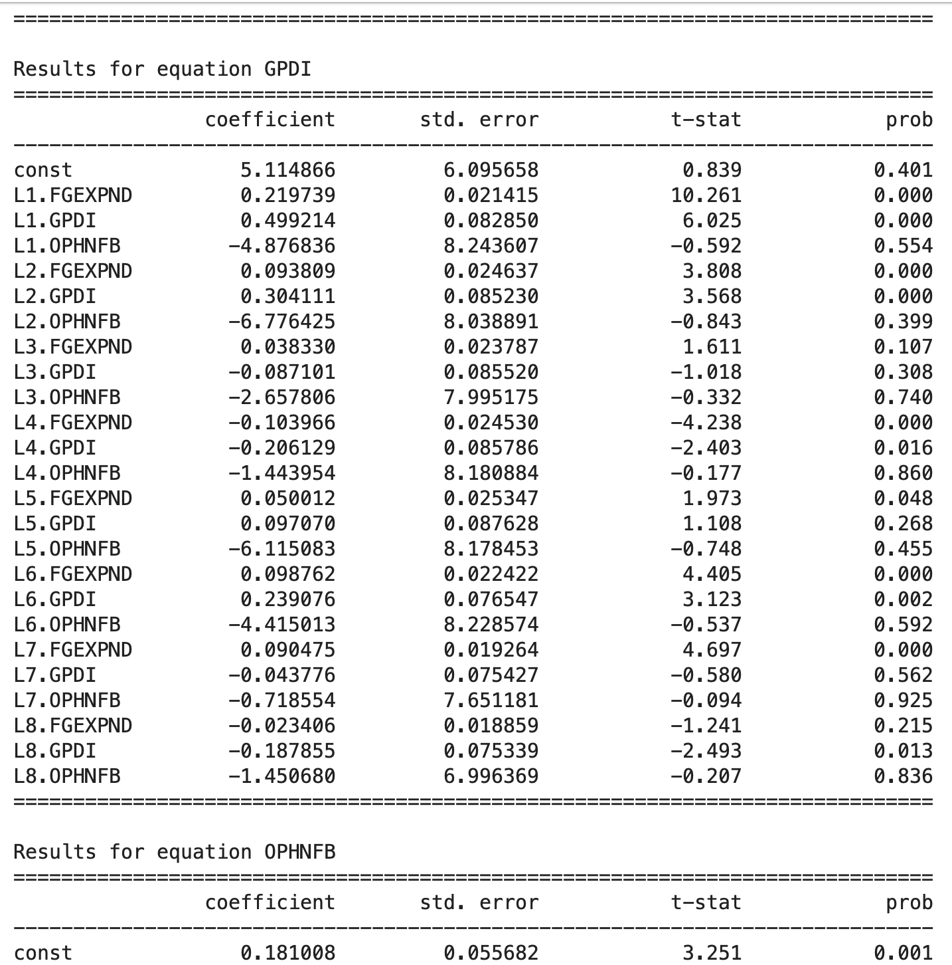
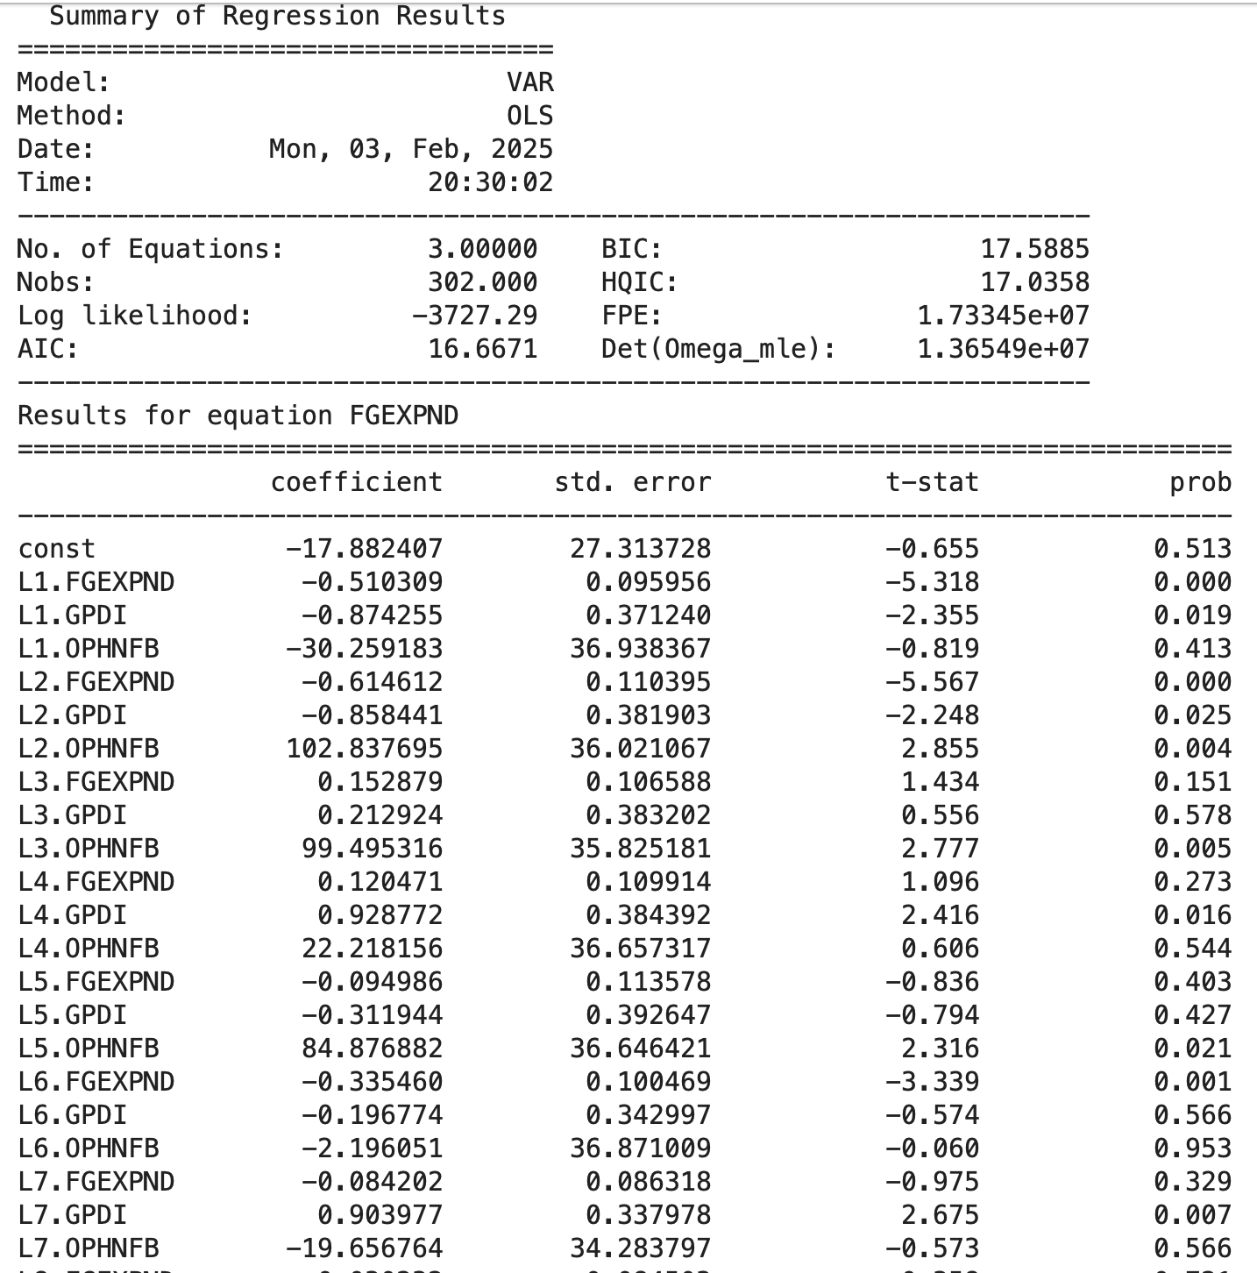

Slide 46
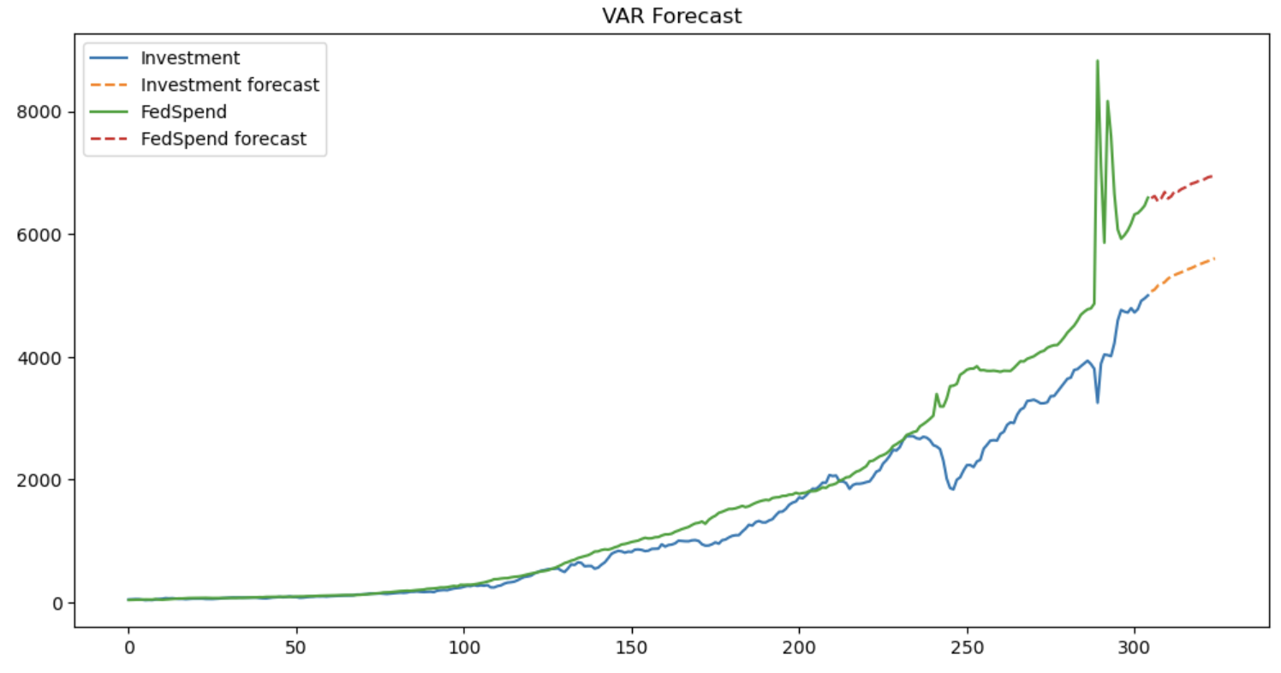

Slide 47
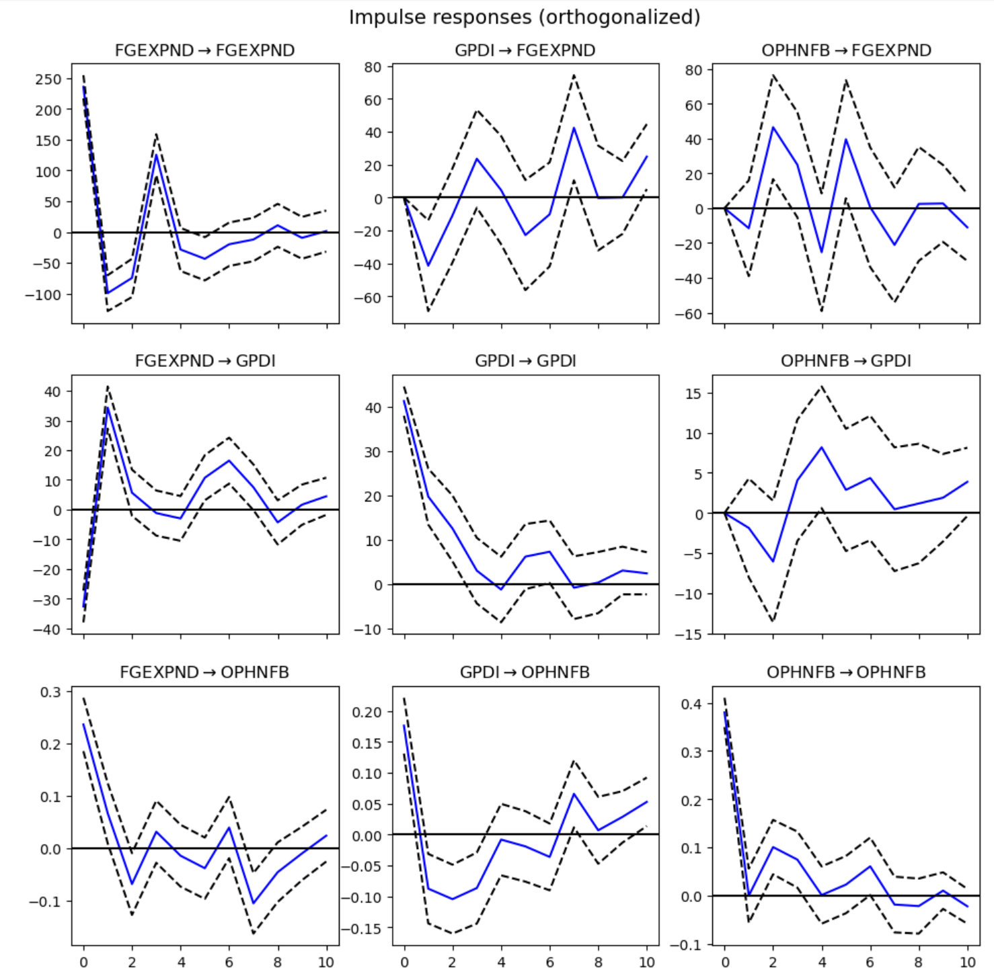
Impulse Response Function
How does each variable respond to a one standard deviation “shock” (one-time change) to the other variables
Ex: If investment spending rises by one standard deviation, how does productivity react over the next several periods

Slide 48
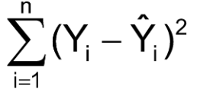
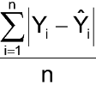
Model Evaluation / Comparison
Sum of Squared Errors
Mean Absolute Deviation

Slide 49
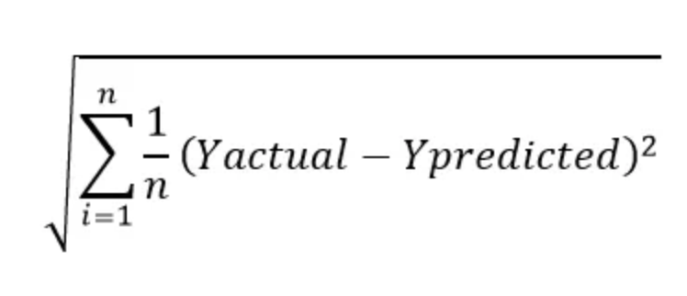
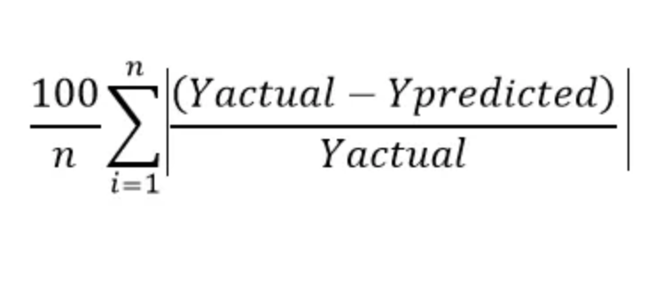
Model Evaluation / Comparison
Root Mean Squared Error
Mean Absolute Percentage Error

Slide 50
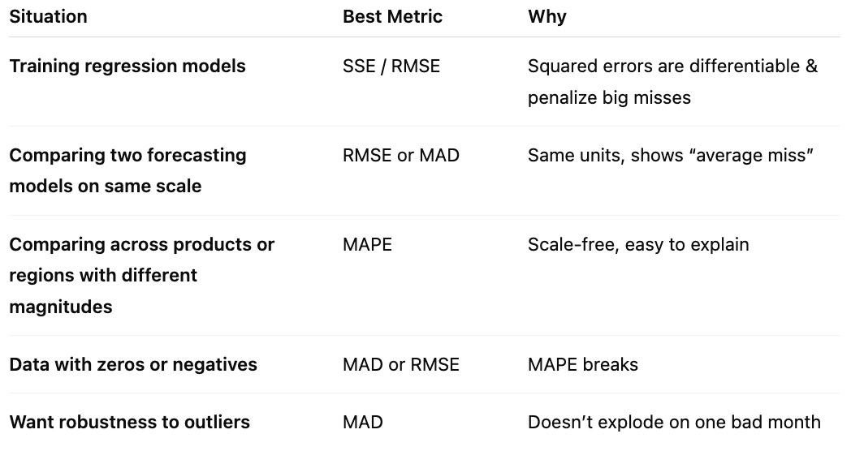

Slide 51
AIC and BIC
Akaike Information Criterion and Bayesian Information Criterion
Used for selecting between models
Both balance goodness of fit (via log-likelihood) and model complexity
Likelihood measures how probable observed series is for a given set of coefficients
AIC = 2k - 2ln(L) (k = parameters, L = max value of likelihood function)
BIC = k ln(n) - 2ln(L)
Lower is better for both
BIC is stricter and selects for simpler models, making it better for understanding lag structure / true model
AIC is less strict on overfitting, making it better for forecasting, but possibly overfitted
A difference in model AIC or BIC > 2 counts as evidence in favor of the model with the lower statistic

Slide 52
Model Validation
Train-Test-Split
Split the series into training and testing data
Training data = First 80% of observations
Testing data = Last 20% of observations
Estimate model coefficients on the training data
Predict values using the testing data
Assess accuracy and/or compare alternative models using MSE, RMSE, etc.
Cross-Validation
Split the series into k number of folds
Use all but one of the folds as the training data and the remaining fold as the testing data
Iterate through the process using each fold as the testing data and the others as the training data
Assess accuracy and/or compare alternative models using average of comparison criteria (MSE, RMSE, etc.)
Must be done “rolling” in TS data
Never shuffle time-series data!

Slide 53
Measuring Volatility - ARCH and GARCH
Generalized AutoRegressive Conditional Heteroskedasticity
GARCH predicts how volatile a series will be based on how how volatile it has been recently
Model is concerned with clustering of volatility (crazy days follow crazy days, boring days follow boring days)
https://github.com/rjwrobel86/Python4Statistics/blob/main/Notebooks/GARCH.ipynb
Mu = Mean value
Omega = Baseline variance
Alpha = Short-run reaction
Beta = Persistence of reaction
Sum of Alpha + Beta = Persistence of volatility

